Slide 1
Defining a Homeless Response System
Part 1
September 14, 2022

Slide 2
Introduce Yourself
Please let us know in the chat:
Your Name
The Community you represent.
Your title/role in your organization

Slide 3
Agenda
1
2
3
4
5
Bring the Local Homeless Response System into Focus
Building Partnerships Across Agencies: Case Study of Imperial Valley
Welcome & Session Overview
Tapping into what we know
Putting Ideas into Practice

Slide 4
Land Acknowledgement
We recognize and acknowledge the First People of this ancestral and unceded territory – the land that today we call California. With respect to their elders, past and present, we recognize the tribal communities as the original stewards of this land and who continue to lift up their stories and cultures.
Adopted from Los Angeles County’s
Land Acknowledgment

Slide 5
Community Agreements
We want to build this space as a brave space to share lessons learned and problem-solve with peers, so let’s ASPIRE:
Assume good intent and take accountability for negative impact (“ouch” and “opps”)
Share airtime (take space, make space)
Practice active listening (with empathy)
I Statements; speak from your own experience
Respect brave and sensitive statements: take what resonates and apply, but leave who said what in the zoom
Everyone is an expert in their own experience, but they don’t represent and entire group
Is there anything that we are missing to make this a safe place for your experience?

Slide 6
Learning Objectives
At the end of today’s webinar, Leaders will be able to:
Name the system-level partners contributing to your local homeless response system and the contributions these partners are making.
Identify potential partnerships within your local homeless response system that would strengthen homeless services.

Slide 7
POLL
How would you describe your current relationship to your local homeless response system?
Choose one response:
Inquiring: What is a homeless response system?
Informal: We make and receive referrals from local providers as needed
Formal: We have MOUs in place for certain programs
Collaborators: We are part of a regional leadership team responsible for planning and coordination
No Relationship
Other
Notes:
Pre-Survey
https://uclasocialwelfare.co1.qualtrics.com/jfe/form/SV_1TyCHmYF7HU3yui

Slide 8
Bringing the Local Homeless Response System into Focus
Defining a Homeless Response System

Slide 9
National Homelessness Goal:
Homelessness in every community becomes rare, brief, and non-reoccurring.

Slide 10
State and National Performance Goals
Reducing the number of people experiencing homelessness.
Reducing the number of people who become homeless for the first time.
Increasing the number of people exiting homelessness into permanent housing.
Reducing the length of time persons remain homeless.
Reducing the number of persons who return to homelessness after exiting homelessness to permanent housing.
Increase successful placements from street outreach.

Slide 11
Robust, diverse workforce including partners with lived experience
Increase permanent housing opportunities
Quality HMIS data with active participation & coverage of all programs
Coordinated Entry System (CES)
Optimal Regional Homeless Response System
Crisis response with a focus on housing
Collaborative & coordinated cross-jurisdictional planning & implementation
Prevention, diversion, and problem-solving resources

Slide 12
Key System Partners
Continuum of Care (CoC)
Service Providers
School Districts
Housing Authorities
Behavioral Health
(Mental Health and Substance Use Services)
Cities and Tribal Communities
Affordable Housing Developers & Landlords
Funders
Courts/Legal Services
Faith-Based Communities
Veteran Affairs
Partners with Lived Experience
First Responders

Slide 13
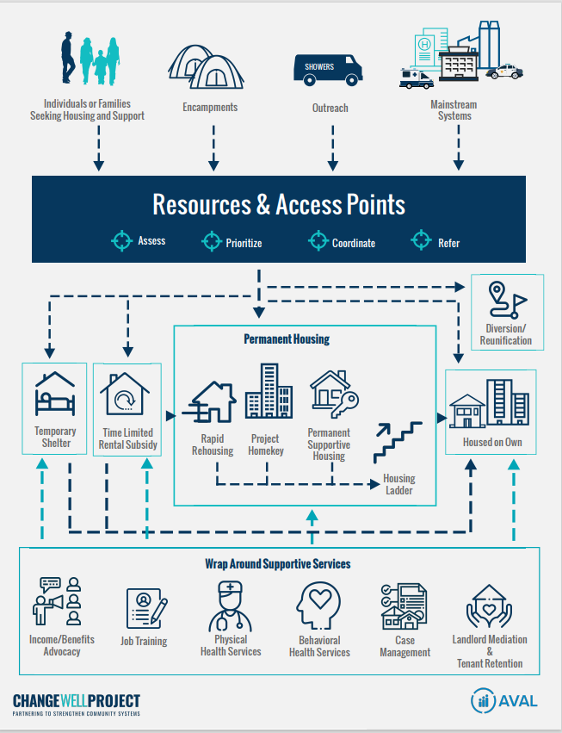

Slide 14
Guiding Principles and Practices
Housing First
Harm Reduction
Client-Centered Approach
Low-Barrier Access to Services
Advancing Racial Equity
Inclusion of Partners with Lived Experience
Regional Collaboration

Slide 15
Considerations for System-Leaders
How much would your full homelessness budget need to be to meet the needs of everyone eligible for your homelessness programs?
What new skillsets and trainings are needed to support your department transition into being a contributor to the local homeless response system?
What policies may need to be waived or modified to remove barriers to accessing your homeless programs?
What organizations could you partner with to build capacity to rehouse people experiencing homelessness in your community?
What data do you need to collect or access to guide your department in these unprecedented times?

Slide 16
Add TA Team Slide

Slide 17
Section Recap
We are in a moment of unprecedented funding and statewide coordination to strengthen local homeless response systems to make homelessness rare, brief, and nonrecurring.
New resources are increasing the number of local actors requiring regional planning and coordination of services to reduce duplication, ensure geographic coverage, and ensure that historically underserved communities & persons with severe service needs are able to access housing and services.
Leadership accountability will increasingly be measured by successful facilitation of local partnerships and collaboration.
This Photo by Unknown author is licensed under CC BY-SA.

Slide 18
Building Partnerships Across Agencies: A Case Study of Imperial Valley
Defining a Homeless Response System

Slide 19
Post-Poll
What would you like your relationship with the local homeless response system to be by the end of this series in June 2023?
Chose a Response:
Inquiring: What is a homeless response system?
Informal: We make and receive referrals from local providers as needed
Formal: We have MOUs in place for certain programs
Collaborators: We are part of a regional leadership team responsible for planning and coordination
No Relationship
Other

Slide 20
Homework
Identify a homeless response system partner and start a conversation to explore starting, formalizing, or deepening a working relationship. Prepare to share your experience at our next webinar.
Part II: Developing Partnerships with Complex Systems
October 12, 2022
ANY
QUESTIONS?
Notes:
About our session:
We are offering three Learning Community Sessions on May 18th, please select one to attend:
Large, condensed communities
Smaller, rural communities
Tribal communities - (We will reach out to Tribal Communities to schedule an event)
The Learning Community is a safe creative space to explore the concepts presented in parts I and II to hear from other communities like yours on how they are thinking about or implementing the concepts, and to share lessons learned.
https://www.changewellproject.com/events/racial-equity-series-session-3-learning-communities-opportunity-for-peers-to-speak-with-peers
Learning Community Ideas
Any challenges getting data
How does your data compare

Slide 21
THANK YOU!
WWW.CHANGEWELLPROJECT.COM

